Slide 1

FBI Virtual Case File
TEAM 2:
XIANGYI ZHANG
PRASRABAN MUKHOPADHYAY
YAXIN JIANG
KUNJA DUTTA
DEBALEENA SAHA
MOHAMMED SHOEB AHMED SHAKEB
SAMARPITA CHAKRABARTY
PRATARSHI SAHA

Slide 2

Case Introduction
GOALS OF TRILOGY PROJECT
Time: 3 years
Budget: US$380 million
Scope: Upgrade of desktop hardware and software, and implementation of a more modern and secure network
ACHIEVED RESULTS
Officially abandoned in January 2005
The first two goals of Trilogy were generally successful
VCF part experienced a loss of $104.5 million out of 170 million investment
OUR STAND
an outside consulting team

Slide 3

Project Charter & Plan
CHARTER
Business Owner: Senator Leahy, Chairman, FBI
Project Sponsor: Michael Zambruski, Chairman, IPM Consultants
Project Manager: Kunja Datta, IPM Consultants
PROJECT PLAN
Project Start Date: 16th September, 2016
Project End Date: 30th November, 2016
Project Status: Successfully Completed
SAMPLE PROJECT STATUS
Project Status Period: 2nd November to 8th November, 2016
Project End Date: 30th November, 2016
Project ID: OPIM5270/B14/Team2

Slide 4

Budget Report
Estimated Budget: $93200
Actual Cost: $93250 (Includes Traveling Cost)
Project Manager Cost: $50/Hour
Team Member Cost: $30/Hour

Slide 5

Priority Matrix
 | High Most Constrained | Medium Some Constraint | Low Least Constrained
SCOPE | Trilogy program-purchase, development and modernization
TIME |  | Limited flexibility in schedule to achieve desired outcomes
COST |  | Additional budget can be allocated to successfully deliver the project
RISK | Highly-critical National Security data crucial to law enforcement
QUALITY | Easy management and access to files relating to FBI cases

Slide 6

Case Research
TIME | EVENT | ANALYSIS
December 2001 | Scope changed. Deadline brought forward from June 2004 to December 2003. | Flawed requirement analysis
December 2002 | Additional funding was requested and approved. | Additional cost to compensate the schedule slippage
December 2003 | Faulty VCF software delivered with 400 defects | Expedited delivery
March 2004 | FBI’s reassurance regarding on time completion of the project. Further claim of funding, which was refused by Bureau. | Unrealistic commitment
May 2004 | Allocation of additional funding to salvage the system. Aerospace Corporation was appointed to review the project. Negative review report released in the fall of 2004. | Further unplanned investment to salvage the project
April 2005 | Discussion about replacement project. Project officially scrapped. | Pulling the plug

Slide 7

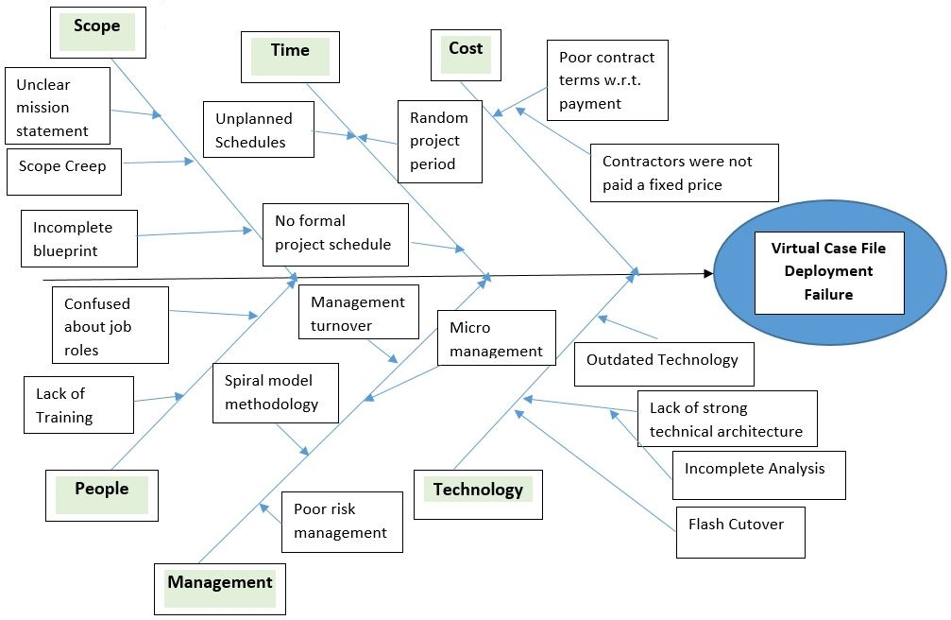
Root Cause Analysis
Figure : Ishikawa Diagram

Slide 8






Systematic Biases
Escalation of commitment to a failing course of action
Illusion of Control
Conservatism
Sunk Cost
Groupthink
Selective Perception

Slide 9

Recommended Approach
SCOPE
Well-defined scope before project conception.
All additional requirements to be incorporated as enhancements.
SCHEDULE
Realistic and achievable schedule.
Schedule should contain milestones and incorporate slack.
COST
Pre-determined cost estimation instead of contract-based volatile investment.
Reserved budget for unaccountable costs.
RISK AND QUALITY
Iterative or Agile approach to foresee impending risks in schedule and tackle changing scope.
Scheduled external audits to ensure quality and early realization of cost traps and slipping schedule.
ORGANIZATIONAL MEASURES
PMO essential to deliver high-budget and extensive project.
Deliver user training across the organization.
Effective transition and handovers during change in ownership.

Slide 10


